Slide 1

Big Data Analysis
Prof. Arjun Vankani
Exploring the foundations and applications of modern computing paradigms.

Slide 2

Distributed and Parallel Computing
Distributed computing involves multiple autonomous computers working together as a single system. These computers communicate and coordinate their actions by passing messages.
Key Characteristics
Concurrency of components
Lack of a global clock
Independent failures of components
Resource sharing

Slide 3
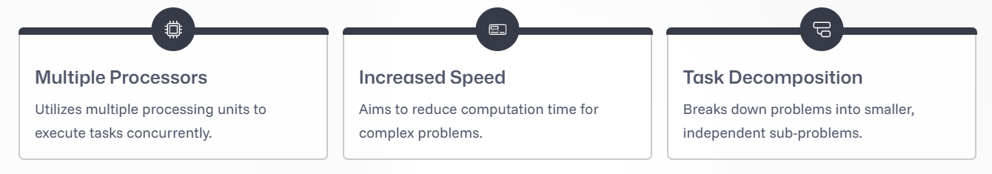
What is Parallel Computing?
Parallel computing is a type of computation in which many calculations or the execution of processes are carried out simultaneously. It's often used to solve large problems faster than sequential computing.

Slide 4
Why Distributed and Parallel Computing in Big Data?
Large, complex datasets beyond traditional processing.
Traditional systems struggle to scale.
Use multiple processors/machines to split and conquer data workload.
Understand the role of distributed and parallel computing in Big Data.

Slide 5
Basics of Distributed Computing
Processing is spread across multiple computers connected by a network.
Each node works independently with coordination via communication protocols.
Tasks are split and distributed.
Examples: Hadoop HDFS, Apache Spark, Google File System.
Use Cases: Web crawling, social media data analysis.

Slide 6
Big Data Tools And Techniques
Big data applications achieve performance and scalability by using a collection of computing and storage resources within a runtime environment.
Awareness of architecture is critical (both hardware & software).
Applications are distributed across multiple nodes to manage large-scale data.
Limited processing, memory, storage, and network capacity.
Can't handle the volume and complexity of big data efficiently.

Slide 7
Core Resources in Big Data Platforms
Big data platforms leverage 4 essential computing resources:
1) Processing Capability (CPU/Node):
Includes multiple cores.
Enables multithreading (parallel task execution).
2) Memory:
Holds the data in active processing.
Limited in single-node machines.

Slide 8
Core Resources in Big Data Platforms
3) Storage:
Provides data persistence.
Datasets are read from storage into memory.
4) Network:
Connects processing and storage nodes.
Transfers large datasets between resources

Slide 9
Introduction to Hadoop
What is Hadoop?
Hadoop is an open-source framework designed for processing and storing big data efficiently.
It was developed by Doug Cutting and Mike Cafarella in 2006.
Hadoop is freely available for anyone to use.
Why Hadoop?
Hadoop provides a distributed computing environment, making it easy and fast to process huge volumes of data.
It solves limitations of traditional systems that struggle with big data.

Slide 10
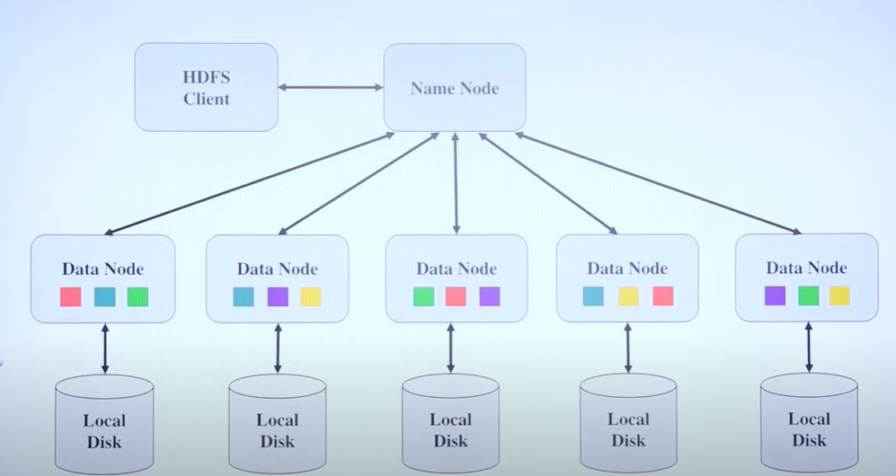
Hadoop Distributed File System

Slide 11
Introduction to Hadoop Architecture
Hadoop is a widely used Big Data framework.
It enables storage and processing of large datasets across multiple machines using simple programming models.
Hadoop Architecture is divided into several important components:
Task Tracker,
Data Node,
Name Node,
Job Tracker,
Slave & Master nodes,
HDFS and MapReduce.

Slide 12
HDFS & MapReduce
Hadoop Distributed File System (HDFS):
HDFS stores data in small blocks across multiple machines (nodes).
Main components: NameNode (master) and DataNodes (slaves).
Block replication ensures data is not lost, even if some nodes fail.
MapReduce:
MapReduce is Hadoop’s computational engine.
It divides tasks (Map phase) and processes them in parallel, then combines results (Reduce phase).
This allows for fast and efficient processing of large data files.

Slide 13
Master-Slave Architecture in Hadoop
HDFS (Hadoop Distributed File System): Divides large data into blocks and stores them across Data Nodes for redundancy and reliability.
Master Node: Typically runs Name Node and Job Tracker roles.
Name Node: Manages metadata—tracking where data blocks are stored and how data is split.
Job Tracker: Divides work into smaller tasks and assigns them to available Task Trackers in the cluster.
Slave Nodes: Run Data Nodes and Task Trackers, executing actual storage and processing tasks.

Slide 14
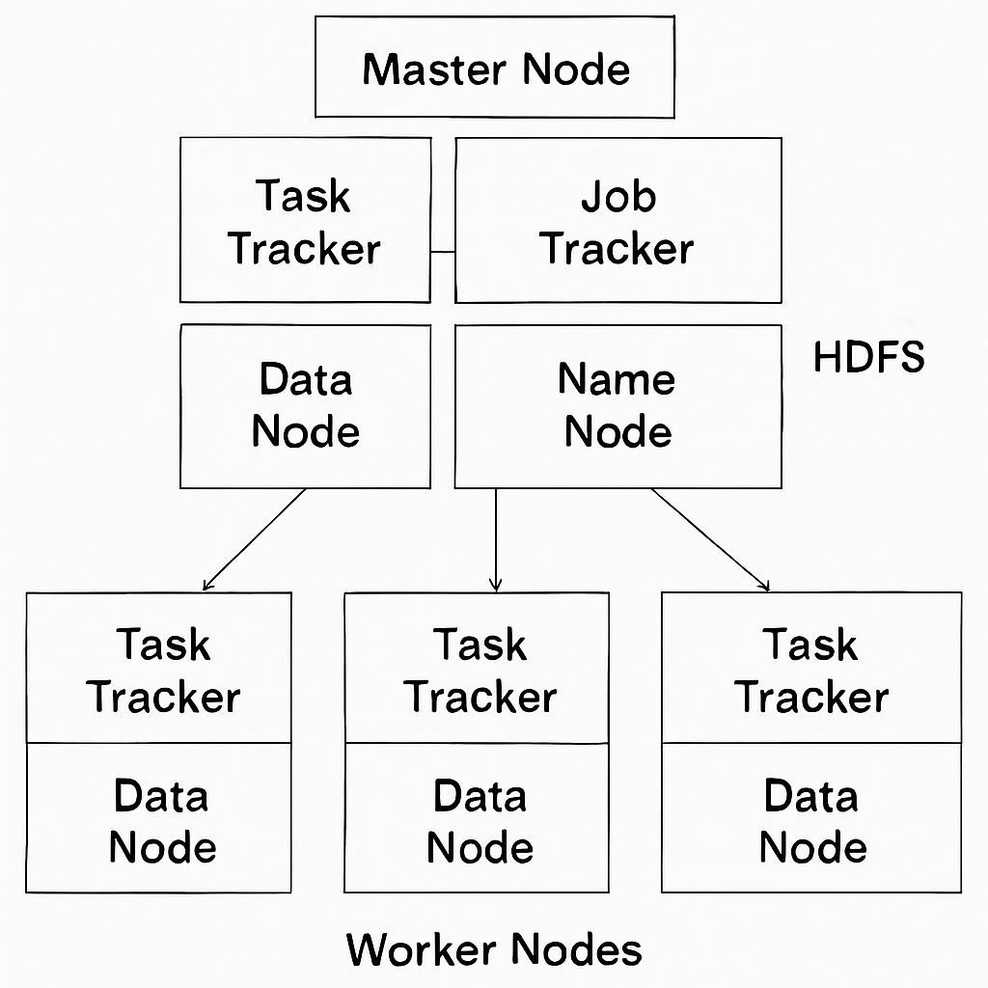
Hadoop Architecture: Master-Slave Model
Master Node: The master node manages the overall cluster and coordinates data storage and processing.
It contains four key components:
1) Name Node: Manages the file system namespace and controls access to files by clients. It’s the central metadata server of the Hadoop Distributed File System (HDFS).
2) Data Node: Stores the actual data. Each block of data is saved in a Data Node, and multiple copies may exist for reliability.
3) Job Tracker: Controls the distribution of MapReduce tasks to various nodes for parallel processing.

Slide 15
Worker/Slave Nodes:
Each worker node contains:
Task Tracker: Handles assigned processing tasks.
Data Node: Stores blocks of the data distributed by HDFS.
Key Services:
HDFS: Comprised of the Name Node and Data Nodes, provides high-throughput access to distributed data storage.
MapReduce: Utilizes the Job Tracker and Task Trackers across nodes for distributed data processing.

Slide 16
Key Components Explained
Data Node: Responsible for storing actual data. Multiple Data Nodes manage data blocks on separate machines for distributed storage.
Task Tracker: Manages assigned tasks, ensuring that data processing happens efficiently and in parallel.
MapReduce: A processing model that splits data processing into two main functions: "Map" and "Reduce"—enabling parallel processing on large datasets, usually using Java language.

Slide 17
Features of Hadoop
1) Fault Tolerance
Data Reliability: Hadoop automatically creates multiple copies of each data block (replication), ensuring data is safe even if a node fails.
Automatic Recovery: If a machine or node in the cluster fails, Hadoop redistributes data and tasks to functioning nodes without loss of information.
Example: If a file is stored with a replication factor of 3, even if two nodes fail, the data is still available.

Slide 18
Features of Hadoop
2) High Scalability
Expandable Clusters: Hadoop clusters can scale from a handful to thousands of servers with minimal administration.
Horizontal Scaling: New nodes can be added to the system easily as data volume grows, without major changes to applications.
Real-World Use: Large organizations use Hadoop to process huge volumes of data efficiently by scaling up clusters as needed.

Slide 19
Features of Hadoop
3) Easy Programming & Flexible Storage
Simple Programming Model: Hadoop’s MapReduce framework allows straightforward processing logic—developers do not need to worry about underlying hardware or distributed computing.
Supports All Data Types: Hadoop stores and processes all kinds of data—structured, semi-structured, or unstructured—like text, images, and videos.
Flexible Storage: No need to preprocess or format data before storing; Hadoop’s storage adapts to the data type and size.

Slide 20
Features of Hadoop
4) Low Cost & Additional Key Features
Cost Effective: Runs on commodity (inexpensive) hardware, dramatically lowering storage and processing costs versus traditional enterprise systems.
Open Source: No licensing fees; Hadoop's code is freely available for anyone to use or modify.
Other Features:
High availability and quick recovery
Supports parallel processing for fast performance
Widely used for big data analytics, data warehousing, and large-scale search engines

Slide 21
Hadoop Ecosystem
Data Ingestion Tools
Flume:
Used to collect, aggregate, and move large amounts of streaming log data from many sources into HDFS or HBase in near-real-time.
Sqoop:
Efficient tool to transfer bulk data between Hadoop and traditional RDBMS (Relational Database Management Systems).
Supports importing data from external databases into HDFS and exporting processed data back.

Slide 22
Hadoop Ecosystem
Data Storage & Query Tools
Hive:
Data warehouse system built on Hadoop, enabling SQL-like queries (HiveQL) on large datasets.
Translates user queries into MapReduce jobs for execution.
HBase:
NoSQL, distributed, column-oriented database for real-time read/write access to large datasets.
Supports random, real-time access and updates—unlike HDFS, which is optimized for batch processing.

Slide 23
Hadoop Ecosystem
Data Processing & Analytics
Pig:
High-level scripting platform (Pig Latin) for analyzing large datasets.
Offers abstraction over MapReduce, making data transformation easier.
Mahout:
A machine learning library for scalable algorithms like classification, clustering, and recommendation engines.
These help data scientists and analysts run complex analytics tasks on massive data efficiently.

Slide 24
Hadoop Ecosystem
Coordination & Management
Zookeeper:
Centralized service for configuration management, synchronization, and naming across Hadoop cluster nodes.
Ensures distributed systems coordination, leader election, and failure recovery.
The entire Hadoop Ecosystem collaborates, with Zookeeper orchestrating reliable and scalable operations for big data applications.

Slide 25
HDFS & Job Scheduling Example
File size = 700 MB
HDFS block size = 128 MB (default in modern Hadoop; earlier default was 64 MB)
Replication factor = 3
Cluster = 4 Data Nodes
Components: Name Node (master), Data Nodes (slaves), Job Tracker, Task Trackers.

Slide 26
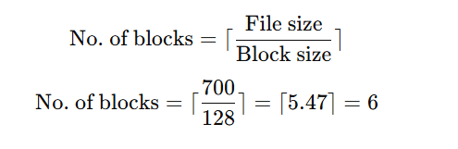
Step 1 — Splitting into HDFS Blocks
So, the file will be split into 6 blocks: B1, B2, B3, B4, B5, B6.

Slide 27
Step 2 — Replication
Replication factor R = 3, so:
Total stored blocks=6×3=18\text{Total stored blocks} = 6 * 3 = 18
Total stored blocks=6×3=18 Each block will be stored on 3 different Data Nodes for fault tolerance.

Slide 28
Step 3 — Distribution Across 4 Data Nodes
Example allocation by Name Node:
Name Node only stores metadata about which Data Node has which block.
Block | Replica 1 | Replica 2 | Replica 3
B1 | DN1 | DN2 | DN3
B2 | DN2 | DN3 | DN4
B3 | DN3 | DN4 | DN1
B4 | DN4 | DN1 | DN2
B5 | DN1 | DN3 | DN4
B6 | DN2 | DN4 | DN1

Slide 29
Step 4 — Job Scheduling
Client submits a MapReduce job to the JobTracker.
JobTracker splits the job into map tasks (1 per block by default).
TaskTrackers on each DataNode run map tasks locally where data is stored (data locality optimization).
After mapping, shuffle & sort happens over the network.
Reduce tasks run on the TaskTrackers assigned by JobTracker.

Slide 30
Workflow Summary
File uploaded → split into blocks → replicated → stored in DataNodes.
NameNode keeps block-location metadata.
JobTracker assigns map tasks close to data.
TaskTracker executes → intermediate output → reduce phase → final output to HDFS.

Slide 31
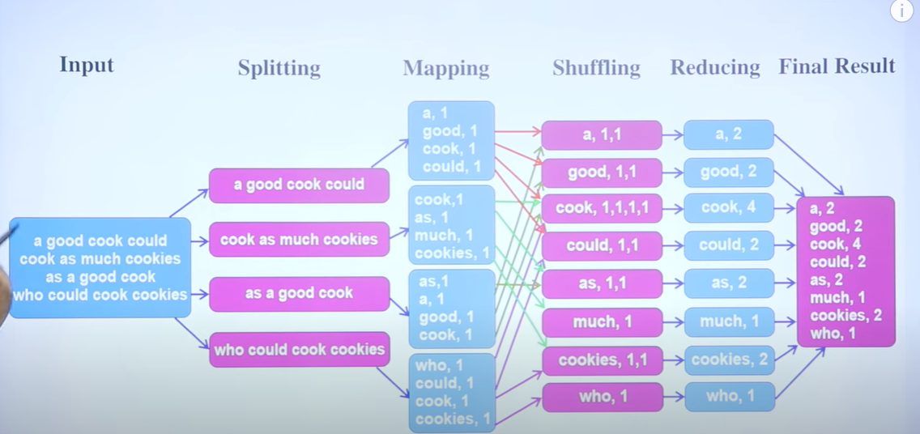
Example of Map reduceing data

Slide 32
MapReduce Sum
You have a log file with the following lines:
INFO: User A logged in
ERROR: Disk space low
INFO: User B uploaded file
ERROR: Connection timed out
INFO: User A logged out
Task: Use MapReduce to count the occurrences of each log level (INFO, ERROR).

Slide 33
Mapping Phase:
INFO, 1
ERROR, 1
INFO, 1
ERROR, 1
INFO, 1

Slide 34
Shuffling:
INFO → (1,1,1)
ERROR → (1,1)

Slide 35
Reducing:
INFO, 3
ERROR, 2

Slide 36
Final Output:
INFO 3
ERROR 2

Slide 37
Job Execution Workflow (MapReduce)
Step 1 – Job Submission
Client submits job to Job Tracker (or Resource Manager in YARN).
Step 2 – Input Splitting
Large file split into blocks (default 128 MB).
Step 3 – Mapping
Each split assigned to a Mapper task.
Output: intermediate <key, value> pairs.
Step 4 – Shuffle & Sort
Keys grouped together across all Mappers.
Step 5 – Reduce
Reducers aggregate values for each key.
Step 6 – Output Storage
Final results stored back in HDFS.

Slide 38
Limitations of Traditional MapReduce
High Latency
Only batch processing; not suitable for live analytics.
Disk I/O Overhead
Writes intermediate data to disk between stages.
Programming Complexity
Requires verbose, low-level Java code.
Poor Iterative Processing
Repeated disk reads slow down ML algorithms.
No Real-time Support
Needs separate streaming tools (Storm, Kafka).

Slide 39
Introduction to Batch Processing
Processing large sets of stored data in scheduled runs.
Processes historical data.
High throughput, but higher latency.
Results not instantly available.
Examples:
Hadoop MapReduce, Apache Spark (batch mode).

Slide 40
Introduction to Real-time Processing
Processing continuous data streams with low latency.
Near-instant insights.
Handles event-by-event processing.
Requires in-memory computation.
Examples:
Apache Storm, Apache Flink, Spark Streaming.

Slide 41
Batch vs Real-time Processing
Feature | Batch Processing | Real-time Processing
Latency | Minutes – Hours | Milliseconds – Seconds
Data Source | Stored Data | Live Data Streams
Throughput | High | Moderate to High
Use Case | Reports, Trends | Monitoring, Alerts

Slide 42
Thank you

